Slide 1
User Cybersecurity
Raymond Schade • Christopher Vieira • Ryan Eastwood • Kyle Ehrlich
Notes:
(introduce all of us)

Slide 2
Argument
Public schools should be required to teach a basic cybersecurity class to mitigate many common security errors people make
Notes:
(short slide)

Slide 3
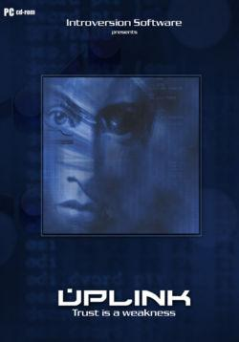
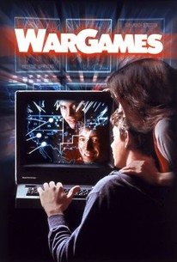
Media
Notes:
Being one of the more popular topics depicted in media, an element that uses or involves cybersecurity is present in the majority of media being created.
On such example that highlights such a topic is the Watch Dogs franchise universe that was created by Ubisoft in 2014.
In this universe every device is connected on the same security network in two major cities, whether it be the city’s infrastructure or something as simple as a citizen’s smartphone or television.
The main idea around the game this universe is displayed in is that there are several individuals and organizations that are able to use this system to gain any information from the mentioned devices along with controlling them remotely.
Due to this vulnerability, any user’s information can be obtained along with some financial information.
The criminal implications of such a vulnerability is obvious and is one of the main themes explored in the two games.
One action frequented by most players is taking funds from the accounts of npcs around the world to fund their endeavours.
Obviously such systems are not in place and their methods of “hacking” are not possible, though an individual’s information can easily be obtained should a database be hacked or if a user mistakenly does something that would lead to their important information being released.
However, when it comes to more well known personal information the ideas mentioned in the universe are not too far fetched due to the incredible amount of information available on a person from basic google searches with certain keywords.
Additionally, banking or credit card information can easily be obtained through scams, especially with phishing attacks that are able to access companies’ databases.
Though the actions the player can perform in the game franchise’s universe seem impossible, there are many which can be done through other means and obtain the same result.

Slide 4
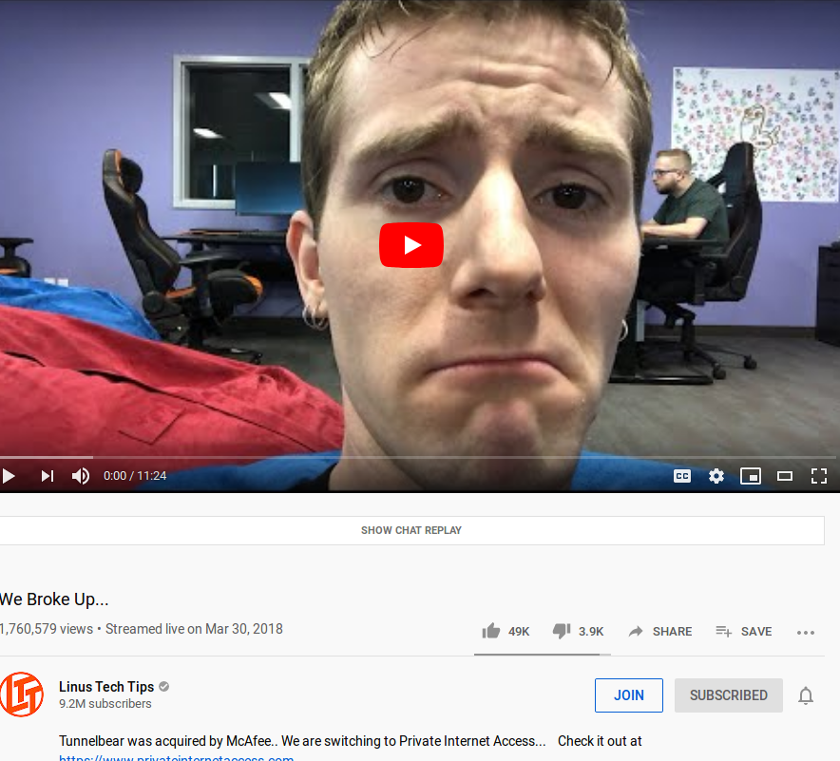
Privacy
VPN
Virtual Private Network
Usually advertise themselves as completely secure [1] [2]
‘No logs’
Security breaches in the past
Fake Antivirus [3]
Many viruses disguise themselves as antiviruses
People don’t know how to discern real from fake (McAfee vs. SpySheriff)
Education could help with all these things
Notes:
Usually when people think about privacy they turn to a virtual private network, or VPN, to try and give it to them. They advertise themselves as making you invisible on the internet and keeping all your information safe, however there are some caveats to this. It’s impossible to know if they are actually keeping your information safe because they are closed companies. They advertise features such as ‘no logs’ but some VPNs have been known in the past to reveal this information to law enforcement. One such case involved a VPN company called HideMyAss (HMA), they gave the logs of a person accused of hacking Sony Entertainment Systems over due to a court order although the VPN advertised itself as secure and strongly suggested they did not keep logs.
Popular internet youtuber Linus Sebastian has sponsored a few VPN providers in the past, changing his sponsorship when they turn out to be unscrupulous or get bought out. He made a video called “we broke up” after TunnelBear was bought by McAfee, and he said he shifted over to being sponsored by Private Internet Access.
Many viruses disguise themselves as antivirus software to trick users into installing it. Even legitimate antivirus software does some virus-like activity like using a fair amount of CPU time and scanning through every file on the host system. However, fake anti-virus software like SpySheriff does things like change your desktop background, display scare imagery and demand you pay money for continued “protection.” Many people fell for SpySheriff and continue to fall for rogue antivirus to this day.
Education can help with all of these things. It may be simple to tech savvy people to not install unverified software or to take the claims VPN providers make at face value, but it isn’t obvious to all people.
Image Source: https://www.youtube.com/watch?v=RNG4-9BqUIQ

Slide 5
Freedom of Speech
Compromised security can compromise anonymity
Expressing freedom of speech makes someone a target
Doxing [4]
SWATing [5]
Notes:
Freedom of speech and privacy are tied together in terms of this topic. When personal security breaks down, people can lose anonymity they thought they had. With identifying information available, if the person is vocal enough they can be at risk for *doxing* which is the publishing of said personal information. [](https://www.economist.com/the-economist-explains/2014/03/10/what-doxxing-is-and-why-it-matters) One of the worst case possible outcomes of this is colloquially referred to as “SWATing:” where a leaked address is used to cause a false aggressive police attack. [](https://www.cnn.com/2019/08/13/us/fortnite-swatting-bugha-trnd/index.html). This effectively means that expressing free speech online can be an avenue for physical harm if your personal security is poor.

Slide 6
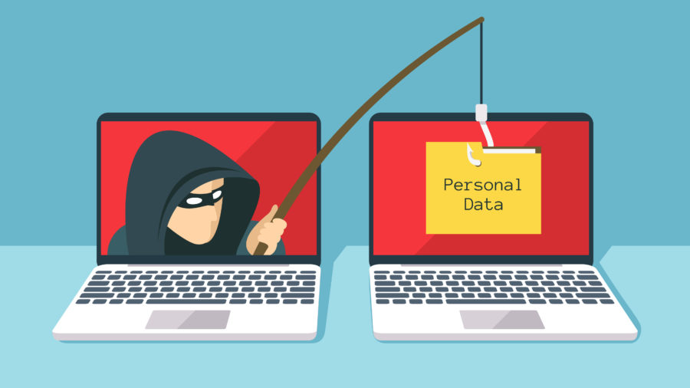
Crime
https://blog.malwarebytes.com/101/2018/09/6-sure-signs-someone-is-phishing-you-besides-email/
Catfishing [6]
43% of males surveyed had been catfished
20% of those surveyed lost money
Phishing [7]
90% of data breaches in 2019
The average cost of financial breaches were 3.6 million dollars
76% of companies reported a phishing attack
16,082 reported incidents [8]
Notes:
One of the main areas to talk about when it comes to Cyber Security is the many ways in which it can be taken advantage of.
An incredible amount of crime is done through the means I’m going to talk about that would be avoidable or at least lessened should the proper education be provided
Catfishing:
A survey was taken involving the respondents to state if they had been catfished, how they felt about it, and other questions involving the ordeal.
43% of males that responded to the survey reported they had been catfished previously
20% of the total pool of respondents reported that they had sent money to those who were catfishing them (person doing the catfishing could be considered to be committing fraud)
Phishing:
90% of data breaches in 2019 were due to phishing attacks
The average cost for a single data breach was 3.6 million dollars
76% of companies reported being a victim of a phishing attack within the last year alone
There have been 16,082 incidents of phishing attacks reported on the Australian Competition & Consumer Commission (ACCC) between January 1st of 2019 and August 31th
References:
https://metro.co.uk/2018/08/06/new-survey-reveals-the-massive-toll-of-catfishing-on-victims-7764000/
https://retruster.com/blog/2019-phishing-and-email-fraud-statistics.html
https://www.scamwatch.gov.au/about-scamwatch/scam-statistics
Picture:
https://blog.malwarebytes.com/101/2018/09/6-sure-signs-someone-is-phishing-you-besides-email/

Slide 7
Intellectual Property
Hackers target individuals within companies to gain access to secrets. [9]
All Employees are a point of vulnerability
1 in 5 companies surveyed have had IP stolen in the past decade [10]
Notes:
Companies thrive off of creating and developing intellectual properties. In many cases the organizations livelihood relies on being the first to introduce an idea to the market. A rising threat to these companies is the theft of IP through hacking. Often companies face the loss of their unique idea, and must be forced to push their product to market faster than planned. Other threats are the loss of trade secrets that give the company a unique edge over the competition. While companies may invest in cybersecurtiy to protect these IPs individuals within the company that are not tech savy pose a threat as they are a weak point in the system. Hackers can compromise an individual and use them to break into the companies system. Because of this, it is an important trait of any employee to be able to minimize hacking risks. However without a proper education, many individuals within the workforce lack the necessary knowledge to protect themselves.

Slide 8
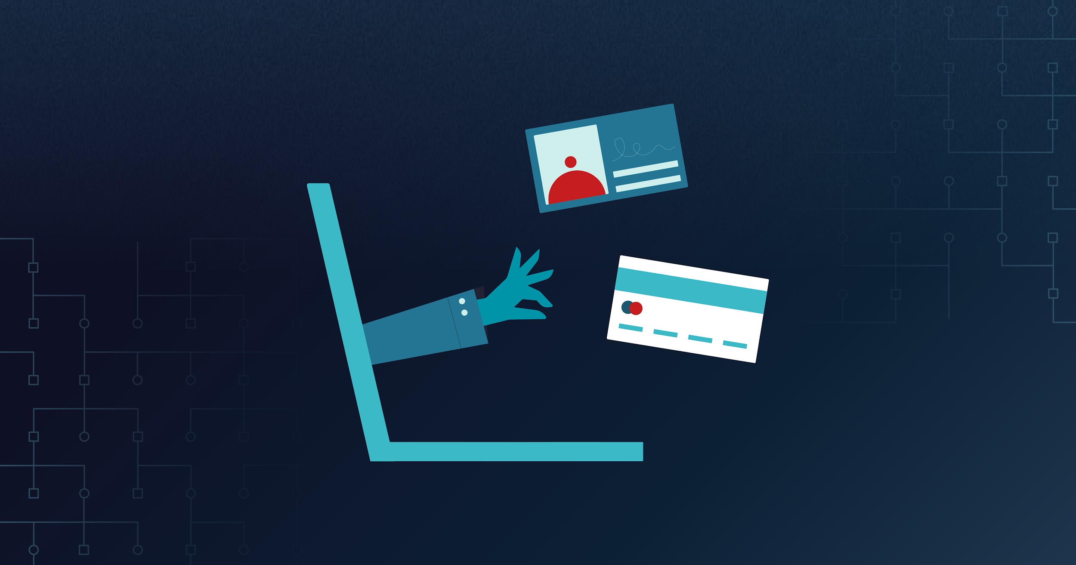
Errors, Failures, and Risks
Security risks stem from poorly written code
Only 24% of students surveyed were required to complete a cybersecurity[11]
Only 4% believed they received the necessary skills training in college [11]
86% said their organizations don’t invest enough in security training [11]
Data Breaches [12]
First American Financial Corp
Facebook
Friend Finder Network
Notes:
Erros, Failures, and Risks:
Security Risks stem from poorly written code more often than not or a lack of proper education
Only 24% of students in a survey stated that they were required to complete a cybersecurity course to graduate
Only 4% believed they received the necessary skills training in college
86% said their organizations don’t invest enough in security training
Such extreme examples of large data breaches can be a result of such inexperienced programmers or those uneducated in scams working in larger companies
Of the 5 largest data breaches reported by June of 2019, 3 were a result of poor security
First American Financial Corp - 885 million affected users
Facebook - 540 million affected users
Friend Finder Network - 412.2 million affected users
References:
https://www.veracode.com/blog/security-news/veracode-survey-research-identifies-cybersecurity-skills-gap-causes-and-cures
https://www.cnbc.com/2019/07/30/five-of-the-biggest-data-breaches-ever.html
Picture:
https://www.varonis.com/blog/data-breach-statistics/

Slide 9
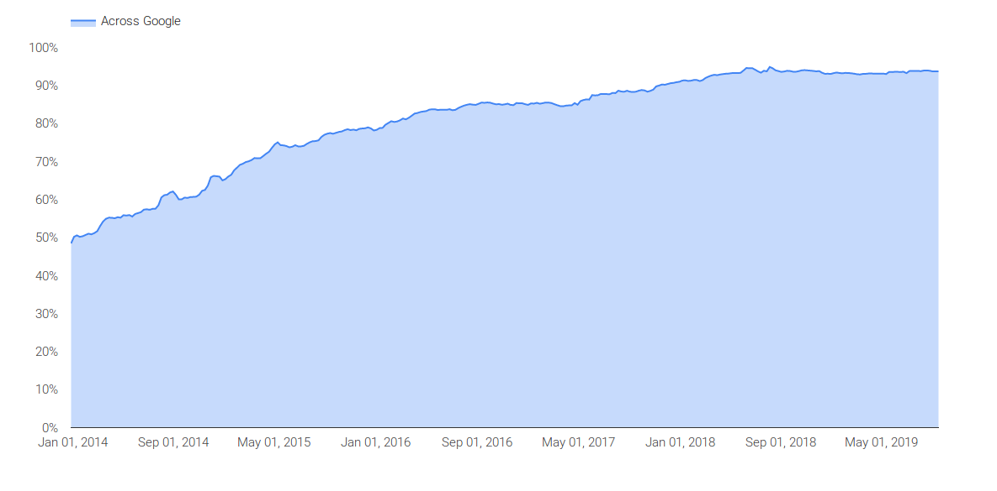
Future Developments
HTTPS Adoption/Let’s Encrypt [13]
Green lock symbols only mean security
Extended validation isn’t foolproof
Internet Explorer 10 EOL [14]
Should help security
Flash Deprecation [14]
Known vulnerabilities
Context-Aware Behavioral Analytics [15]
Unusual file movements
Bioprinting
Encrypted Traffic Across Google
Notes:
Future developments include improved security, deprecation of old technologies and new technologies.
HTTPS adoption has increased since it has been introduced, instead of being an optional protocol for very secure things it has become mostly the norm across the internet for all traffic. As you can see to the left the amount of encrypted traffic through Google has increased from 50% to 90% from 2014 to 2019. However, people associate HTTPS with completely secure browsing however it just means that the traffic from your PC to the server is secure. A phishing attack is still possible with HTTPS. Some users don’t know that a green lock symbol does not mean that the site they are connecting to is correct, it just means the traffic is encrypted (need number of users). Some of the security measures used to prevent this include extended validation, which is the company name in the browser bar. However, it’s hard to tell if EV should be present or if the site doesn’t use it.
Internet Explorer 10 and Flash will be deprecated and marked as obsolete in 2020. Flash has had several known vulnerabilities in the past and it’s no longer being actively developed. Hopefully by forcefully ending support like this more people will migrate their sites away from flash and people will stop visiting them with IE10.
Context-Aware Behavioral Analytics involve a security system which can monitor and identify suspicious behaviour and or transactions. The software will build a model of the user and detect changes in the system that are out of character. This can range from how fast the user is moving files to viewing the typing speed and mouse movement of employees. This has a slew of security applications, one of the larger areas being identifying spoof callers. This technology could be applied to antivirus software and to detect zero-day exploits by detecting these out of character operations.
Based on these developments, security will be improved in the upcoming years however it still will not be foolproof to secure yourself online and formal education is necessary for the general population.
References:
https://www.ecpi.edu/blog/new-cybersecurity-technologies-what-is-shaking-up-the-field (used for context-aware behavioral analytics)
Image source: https://transparencyreport.google.com/https/overview?hl=en

Slide 10
References
NORDVPN, All you need for a better online experience, https://nordvpn.com/features (September 14th)
McAfee, McAfee® Safe Connect, https://www.mcafee.com/consumer/en-us/store/m0/catalog/msc_558/mcafee-safe-connect.html (September 13th)
Symantec, SpySheriff, https://www.symantec.com/security-center/writeup/2005-122910-4625-99?tabid=2 (September 17th)
The Economist, What doxxing is, and why it matters, https://www.economist.com/the-economist-explains/2014/03/10/what-doxxing-is-and-why-it-matters (September 21th)
Leah Asmelash, Teen Fortnite World Champion Kyle 'Bugha' Giersdorf was 'swatted' during a livestream, https://www.cnn.com/2019/08/13/us/fortnite-swatting-bugha-trnd/index.html (September 18th)
Marianna Eloise, New survey reveals the massive toll of catfishing on victims, https://metro.co.uk/2018/08/06/new-survey-reveals-the-massive-toll-of-catfishing-on-victims-7764000/ (September 20th 2019)
Retruster, 2019 Phishing Statistics and Email Fraud Statistics, https://retruster.com/blog/2019-phishing-and-email-fraud-statistics.html (September 20th 2019)
Australian Competition & Consumer Corporation, SCAMWATCH, https://www.scamwatch.gov.au/about-scamwatch/scam-statistics (September 20th 2019)
Don Fancher,5 insights on cyberattacks and intellectual property, https://www2.deloitte.com/content/dam/Deloitte/us/Documents/finance/us-fas-five-insights-on-cyber-attacks-and-intellectual-property.pdf (September 19th)
Eric Rosenbaum,1 in 5 corporations say China has stolen their IP within the last year: CNBC CFO survey, https://www.cnbc.com/2019/02/28/1-in-5-companies-say-china-stole-their-ip-within-the-last-year-cnbc.html (September 18th)
John Zorabedian, Veracode Survey Research Identifies Cybersecurity Skills Gap Causes and Cures, https://www.veracode.com/blog/security-news/veracode-survey-research-identifies-cybersecurity-skills-gap-causes-and-cures (September 15th)
Kenneth Kiesnoski,5 of the biggest data breaches ever, https://www.cnbc.com/2019/07/30/five-of-the-biggest-data-breaches-ever.html (September 14th)
Casey Tilton, The Uncertain Effects of HTTPS Adoption on Access to Information Worldwide, https://medium.com/berkman-klein-center/the-uncertain-effects-of-https-adoption-on-access-to-information-worldwide-fa0c94ba124a (September 23th)
Microsoft, Lifecycle FAQ—Internet Explorer and Edge, https://support.microsoft.com/en-us/help/17454/lifecycle-faq-internet-explorer (September 24th)
ECPI University, New Cybersecurity Technologies: What is Shaking Up the Field?, https://www.ecpi.edu/blog/new-cybersecurity-technologies-what-is-shaking-up-the-field (September 17th)
Notes:
Questions?
https://nordvpn.com/features
https://www.mcafee.com/consumer/en-us/store/m0/catalog/msc_558/mcafee-safe-connect.html
https://www.symantec.com/security-center/writeup/2005-122910-4625-99?tabid=2
https://www.economist.com/the-economist-explains/2014/03/10/what-doxxing-is-and-why-it-matters
https://www.cnn.com/2019/08/13/us/fortnite-swatting-bugha-trnd/index.html
Marianna Eloise, New survey reveals the massive toll of catfishing on victims, https://metro.co.uk/2018/08/06/new-survey-reveals-the-massive-toll-of-catfishing-on-victims-7764000/ (September 20th 2019)
Retruster, 2019 Phishing Statistics and Email Fraud Statistics, https://retruster.com/blog/2019-phishing-and-email-fraud-statistics.html (September 20th 2019)
Australian Competition & Consumer Corporation, SCAMWATCH, https://www.scamwatch.gov.au/about-scamwatch/scam-statistics (September 20th 2019)
https://www2.deloitte.com/content/dam/Deloitte/us/Documents/finance/us-fas-five-insights-on-cyber-attacks-and-intellectual-property.pdf
https://www.cnbc.com/2019/02/28/1-in-5-companies-say-china-stole-their-ip-within-the-last-year-cnbc.html
https://www.veracode.com/blog/security-news/veracode-survey-research-identifies-cybersecurity-skills-gap-causes-and-cures
https://www.cnbc.com/2019/07/30/five-of-the-biggest-data-breaches-ever.html
https://medium.com/berkman-klein-center/the-uncertain-effects-of-https-adoption-on-access-to-information-worldwide-fa0c94ba124a
https://support.microsoft.com/en-us/help/17454/lifecycle-faq-internet-explorer
https://www.ecpi.edu/blog/new-cybersecurity-technologies-what-is-shaking-up-the-field

Slide 11
References (Pictures)
https://en.wikipedia.org/wiki/Black_Mirror
https://en.wikipedia.org/wiki/Watch_Dogs
https://en.wikipedia.org/wiki/Watch_Dogs_2
https://www.rottentomatoes.com/m/wargames
https://www.amazon.co.uk/gp/video/detail/B01HDODNBS/ref=atv_hm_hom_3_c_RdMk00_brws_8_28
https://en.wikipedia.org/wiki/Uplink_(video_game)
https://blog.malwarebytes.com/101/2018/09/6-sure-signs-someone-is-phishing-you-besides-email/
https://www.veracode.com/blog/security-news/veracode-survey-research-identifies-cybersecurity-skills-gap-causes-and-cures
https://www.symantec.com/security-center/writeup/2005-122910-4625-99?tabid=2
https://www.varonis.com/blog/data-breach-statistics/
https://www.youtube.com/watch?v=RNG4-9BqUIQ
https://transparencyreport.google.com/https/overview?hl=en
Notes:
Questions?
References to include:
From Crime:
References:
https://metro.co.uk/2018/08/06/new-survey-reveals-the-massive-toll-of-catfishing-on-victims-7764000/
https://retruster.com/blog/2019-phishing-and-email-fraud-statistics.html
https://www.scamwatch.gov.au/about-scamwatch/scam-statistics
Picture:
https://blog.malwarebytes.com/101/2018/09/6-sure-signs-someone-is-phishing-you-besides-email/
From Media:
Shut up and dance (Black Mirror)
https://en.wikipedia.org/wiki/Black_Mirror
Watchdogs
https://en.wikipedia.org/wiki/Watch_Dogs
https://en.wikipedia.org/wiki/Watch_Dogs_2
Wargames
https://www.rottentomatoes.com/m/wargames
https://cybersecurityventures.com/movies-about-cybersecurity-and-hacking/ List of random hacking movies
Mr. Robot (coffee shop hackers)
https://www.amazon.co.uk/gp/video/detail/B01HDODNBS/ref=atv_hm_hom_3_c_RdMk00_brws_8_28
Podcast ads for VPN / password managers (what security are they advertised to have vs. what do they actually have)
Uplink (2001)
https://en.wikipedia.org/wiki/Uplink_(video_game)

